Slide 1
CSS
GRID
By Mykhailo Torskyi

Slide 2
LAYOUT
Grid layouts are fundamental to the design of websites, and the CSS Grid module is the most powerful and easiest tool for creating it.

Slide 3
BROWSER SUPPORT
Chrome (including on Android)
Firefox
Safari (including on iOS)
Opera
Internet Explorer 10 and 11 on the other hand support it, but it’s an old implementation with an outdated syntax.

Slide 4
CONTAINER
Add “display: grid” to make element behave as grid container

Slide 5

GRID TEMPLATE
Set the column and row sizes with template columns and template rows, and then place its child elements into the grid with column and row

Slide 6
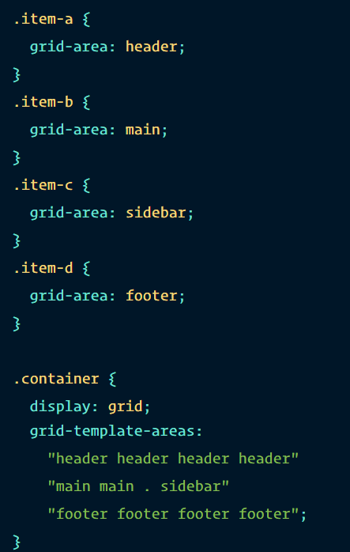
TEMPLATE AREAS
Defines a grid template by referencing the names of the grid areas which are specified with the grid-area property

Slide 7
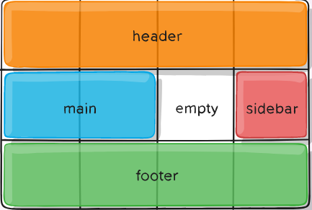
TEMPLATE AREAS

Slide 8
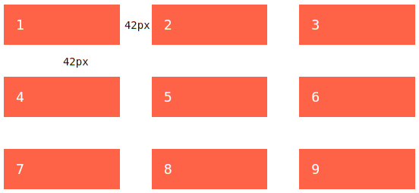
GRID GAP
Specifies the size of the grid lines. Gap is like setting the width of the gutters between the columns/rows

Slide 9
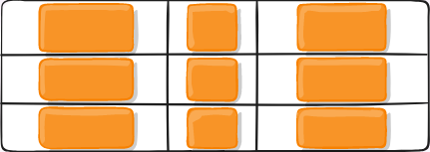
ALIGN & JUSTIFY
Justify items aligns grid items along the inline
Align items aligns along the block
Values: start, end, center, stretch
Place-items

Slide 10
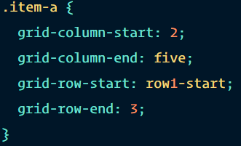
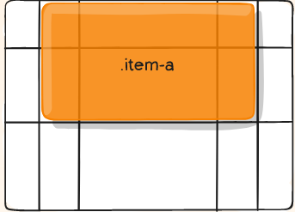
GRID ITEMS
grid-column-start
grid-column-end
grid-row-start
grid-row-end

Slide 11
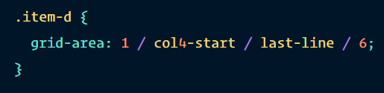
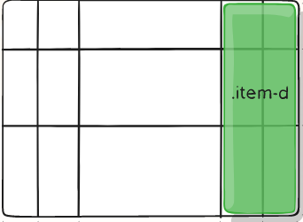
GRID AREA
Gives an item a name so that it can be referenced by a template created with the grid-template-areas property

Slide 12
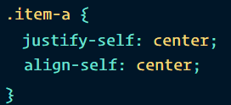
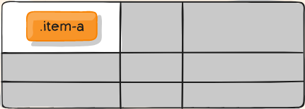
ITEM ALIGN
Justify-self
Align-self
place-self

Slide 13


